Slide 1

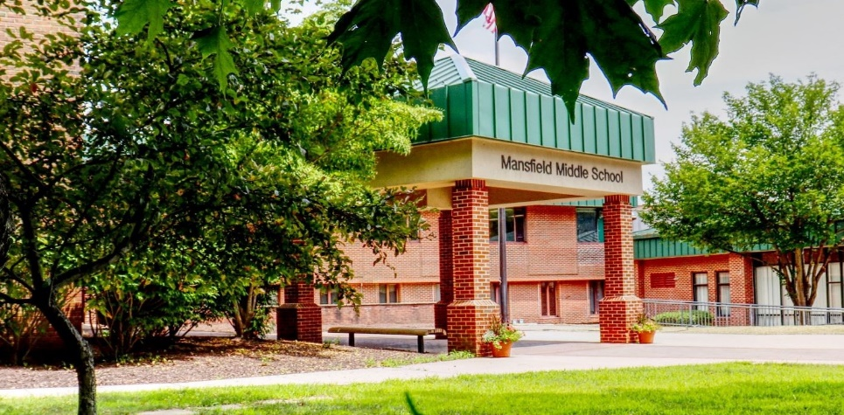
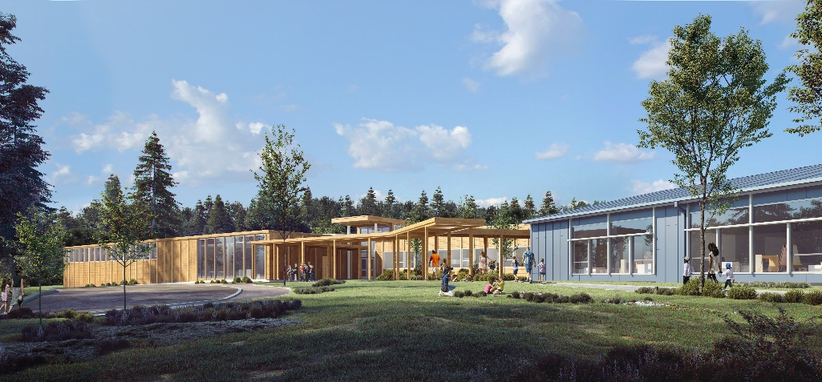
Superintendent’s Proposed Budget 2022-2023

Slide 2



It is the Mission of the Mansfield Public Schools, in partnership with the Mansfield community, to ensure that each and every child develops the knowledge, skills, and dispositions essential for civic engagement and personal excellence in learning, life, and work within our local and global community.
May 2021

Slide 3
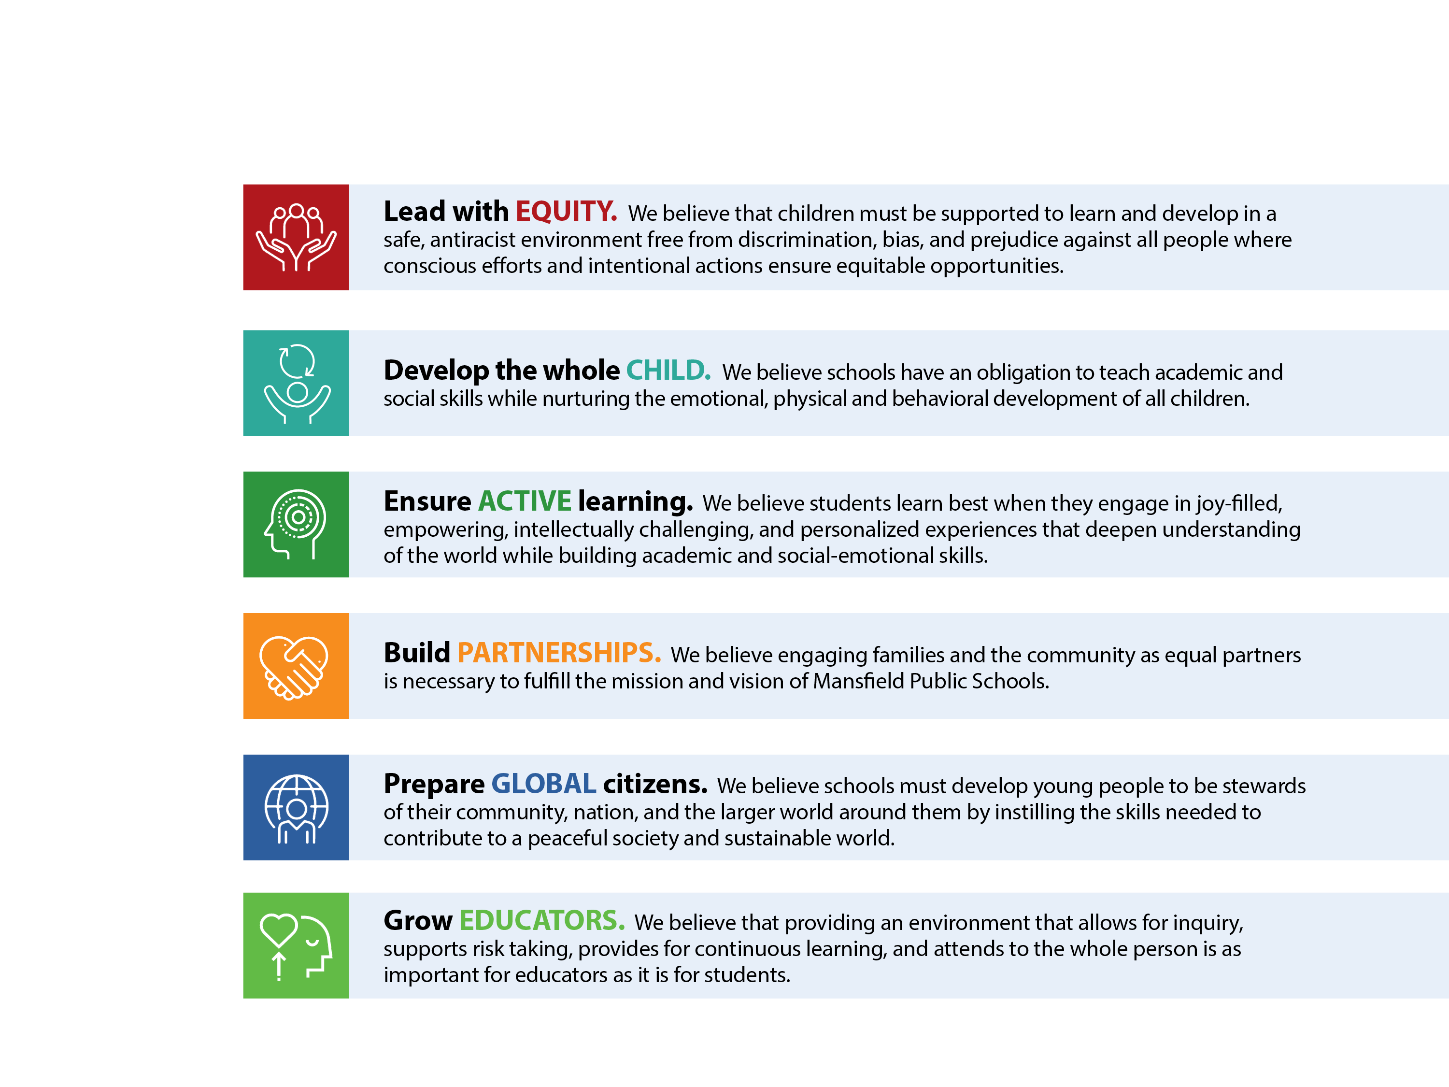


Core Beliefs
May 2021

Slide 4
Accomplishments
Maintained full in-person instruction to date in 2021-22 despite pandemic challenges.
Development and implementation of new strategic plan.
Recognized by US News and World Report among top elementary schools (621 in total) and middle schools (304 in total) in Connecticut.
Mansfield Middle School #18 Goodwin School #12
Vinton School #75 Southeast School #198
Connecticut Teacher of the Year – Kim King.

Slide 5
Accomplishments continued
26 students participated in the CT Regionals History Day Project. 16 advanced to State History Day and 10 advanced to Nationals.
MMS was semi-finalist in Southern New England Science Quiz Bowl competition.
State recognition for two MMS students as winners of Martin Luther King Day essay contest and Fire Prevention Poster Contest.
Provide free to all breakfast and lunch program resulting in increase in participation from 20% to 50%.
Revised summer school program and increased participation through partnership with local arts agencies.

Slide 6
Accomplishments continued
Used grant funding to provide one-to-one or small group instruction in literacy to 59 students beyond regular school programming.
Free to all elementary strings program resulting in 91 participants in grades 2-4.
Replacement of Mansfield Middle School roof and addition of photo-voltaic system.
Construction of new Mansfield Elementary School and activities to support transition of three elementary schools underway.

Slide 7
Schooling in the Time of a Pandemic
Provide programs to accelerate student learning.
Continue to support social and emotional reactions and needs brought on by recent experiences.
Enhanced nursing and family outreach supports.
Continue implementation of mitigation strategies: masking, distancing, cleaning, contact tracing.
Provide learning plan for children unable to attend school due to quarantine or isolation restrictions.

Slide 8
Student Profile October 1, 2021
996 Students PreK – Grade 8
29% Qualify for Free/Reduced Meals
14% Receive Special Education Services
5% Identified English Language Learners

Slide 9
Class Size
BOE Guidelines
Grade | Number of Students per Class
K-3 | 14-18
4-5 | 16-20
6-8 | 21-23
Actual Class Size Academic Core Courses
Grade | Average Class Size
K-3 | 15
4 | 15
5 | 18
6-8 | 19

Slide 10
Proposed Budget 2022-2023
Major Cost Drivers
Increases and Reductions:
Obligated Salary Increases - $58,790
Employee Benefits (Health Ins./MERS) - $234,950
Transportation – Contract Increase, Special Education Increase, and MES Needs- $134,200
Outplacement Tuition – $175,000
Shared Custodial Supervisor Position - $33,536
Net Reductions in Staffing MES – ($884,567)
Energy Savings – ($199,020)
Building Operations – ($68,750)
Magnet School Tuition – ($35,000)
2022-23 Proposed $24,260,760
2021-22 Budget $24,006,080
Increase $ 254,680
% Increase 1.06%

Slide 11
Budget History
Year | Approved Budget | % Incr/(Decr)
2012-13 | $20,588,160 | 0.00%
2013-14 | $20,688,160 | .49%
2014-15 | $21,193,884 | 2.40%
2015-16 | $22,022,750 | 3.90%
2016-17 | $22,980,500 | 4.35%
2017-18 | $22,460,160 | 2.09%
2018-19 | $23,460,160 | 0.00%
2019-20 | $23,637,850 | 0.80%
2020-21 | $23,467,540 | (0.73%)
2021-22 | $24,006,080 | 2.29%
Average Budget Increase 2012-2022: 1.56%
Change in Enrollment 2012-2022: -324 students

Slide 12
Special Education Costs
Special education costs have been contained through careful planning and programming to meet individual needs within Mansfield Public Schools.
Percent of budget allocated to special education costs
2014-2015 13.4%
2015-2016 13.3%
2016-2017 13.1%
2017-2018 12.9%
2018-2019 13.2%
2019-2020 13.6%
2020-2021 12.9%
2021-2022 13.2%
2022-2023 12.8%

Slide 13
MES Staffing Adjustments 2022-23
Reductions:
2.0 Principals
5.2 Certified Elementary
7.5 Non-Certified Elementary
Additions:
1.0 Director of Teaching and Learning
1.0 Assistant Principal
1.0 Library/Media Specialist
Net Change = (11.7) positions

Slide 14
Proposed Staffing Additions 2022-23
District:
1.0 Technology Integrationist
1.0 Specialized School Psychologist
.5 Custodial Supervisor (Full-Time Shared Town Position)
MMS
1.0 MMS Literacy Acceleration Teacher (Reassign Current Teacher)

Slide 15
Capital Fund Requests
Technology – Support regular updating and maintenance of all information technology systems (infrastructure and hardware)
$150,000
Maintenance – Replacement MMS Auditorium Lighting
$125,000

Slide 16
Proposed Budget – Salaries
Salary costs account for 63.9% of operating budget
Net reduction of 11.7 positions due to school consolidation
Addition of 2.5 positions to address student and district needs
Reassign 1 MMS teacher to address pandemic effect
Includes step and gross wage increases for all staff
2022-23 Proposed $ 15,515,540
2021-22 Budget $ 15,456,750
Increase $ 58,790
% Increase 0.4%

Slide 17
Proposed Budget – Benefits
Benefits costs account for 18.98% of operating budget
Medical Insurance accounts for 67.56% of benefit costs
Medical Insurance increase of 7% - $226,490
MERS & Workers Comp Contribution increase - $42,660
Reduction of over ($200,00) due to school consolidation staffing changes
2022-23 Proposed $ 4,606,610
2021-22 Budget $ 4,371,660
Increase $ 234,950
% Increase 5.4%

Slide 18
Proposed Budget – Services
Transportation cost increase due to contracted rate increase of 3.3%
Transportation cost increase due to new school - $54,140
Transportation cost increase for special education - $50,000
Outplaced tuition increase - $175,000
Repairs & Maintenance Services decrease – ($58,600)
2022-23 Proposed $ 3,116,475
2021-22 Budget $ 2,898,455
Increase $ 218,020
% Increase 7.5%

Slide 19
Proposed Budget – Supplies
Energy accounts for 35.95% of this category
FY21/22 Total = $502,610 vs FY22/23 Total = $303,080
Decrease by ($199,530)
Due to closing of 2 elementary schools and photo voltaic panels
Building supplies decrease of ($7,250)
2022-23 Proposed $ 843,055
2021-22 Budget $ 1,040,055
Decrease ($ 197,000)
% Decrease (18.94%)

Slide 20
Proposed Budget – Equipment
Educational Equipment accounts for the majority of this category
Overall decrease (5.3%)
2022-23 Proposed $ 117,050
2021-22 Budget $ 123,600
Decrease $ (6,550)
% Decrease (5.3%)

Slide 21
Proposed Budget – Other Programs
Suzuki program now included in operating budget
Oak Grove Montessori
Provides services of a school nurse
Summer School
Middle School program
Special Services program
2022-23 Proposed $ 29,000
2021-22 Budget $ 47,000
Increase $ 18,000
% Increase 38.3%

Slide 22
Next Steps
January 27 Workshop: 7:00pm
Staffing
Regular Programs – Elementary School and Middle School
February 3 Workshop: 7:00pm
Support Services, Special Education
District Management, Facilities, Other
February 10 Board Meeting: 7:00pm
Budget Review and Adoption

Slide 23
Budget Development Process

Slide 24
Budget Development
Examined expenditures from past three years across each school and department
Identified reductions and needs for each account line
Continued some realignment of accounts to reflect actual expenses by budget line/category
Reviewed actual and projected enrollment and developed staffing proposal

Slide 25
Budget Process
Kick-off meeting to distribute instructions, worksheets, and any specific guidelines
Administrators prepare their narratives & requested budgets
Superintendent and Finance Director meet with all Administrators to review their proposals
Line by line review including supporting information for requests
Staffing and Class size review
Superintendent finalizes proposed budget

Slide 26
Budget Process
Board of Education Reviews – May Recommend Changes
Board of Education Adopts Budget
Town Manager Proposes Budget to Town Council which includes the Board Adopted Budget
Town Council Reviews – May Recommend Changes to Manager’s Proposed Budget or the Board of Education Adopted Budget (Bottom Line only)
Town Council Adopts Budget for presentation to the Voters at Town Meeting

Slide 27
Budget Account Structure
Budget Account Structure
Fund | Program or Activity | Object | Location
Grouping of related accounts | Identifies the program or activity that you want to track | Identifies the type of expense or the source of revenue | Identifies an actual location or grouping of programs
1010 (Board of Ed) | 61104 (World Languages) | 54109 (Instructional Software) | 01 (Middle School)

Slide 28
The Budget Document
Communications Device – Policy, Financial and Operational Information
Overview
Narrative discussion of budget as a whole; key points
Board Goals
Enrollment & Staffing Summaries
Budget in Brief & Significant Features
Budget Summaries
By Object
By Program
By Location (K-4 and 5-8 summaries)

